Slide 1



Slide 2
Source Code Component Based Recommendation System CODEGO

Slide 3

THINGS TO DISCUSS
INTRODUCTION
PROBLEM STATEMENT
RESEARCH GAP
OBJECTIVE
SCOPE
CONCLUTION

Slide 4

Motivation
Motivation
We live in a world which is full of information all around.
Exponential increase in information with each passing second.
Digging out precise and relevant information has become the necessity and critical need of the time.
Notes:
We define five metrics for measuring a component's understandability, adaptability, and portability, with confidence intervals that were set by statistical analysis of a number

Slide 5

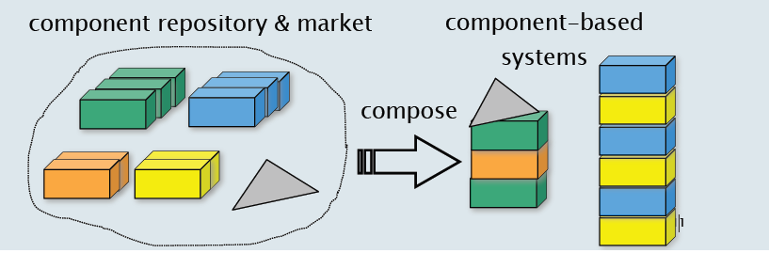
introduction
CODEGO
What is SCBSD (Source code Component Based software Development)?Namely
Software development processes involve finding reusable source code components from Online source code repositories and question answering communities, such as GitHub or Stack Overﬂow, have facilitated the task of ﬁnding suitable (with respect to a developer query) source code and integrating them with other developed components to create system.
Notes:
We define five metrics for measuring a component's understandability, adaptability, and portability, with confidence intervals that were set by statistical analysis of a number
During the last few decades, with the rise of You-tube, Amazon, Netflix and many other such web services,

Slide 6



introduction
Why SCBSD (Source code Component Based software Development)?
Notes:
We define five metrics for measuring a component's understandability, adaptability, and portability, with confidence intervals that were set by statistical analysis of a number
During the last few decades, with the rise of You-tube, Amazon, Netflix and many other such web services,

Slide 7



introduction
Why SCBSD (Source code Component Based software Development)?
Reduce both developer time for searching large repositories
and development time
Software project is of high quality.
Increases productivity.
Notes:
We define five metrics for measuring a component's understandability, adaptability, and portability, with confidence intervals that were set by statistical analysis of a number
During the last few decades, with the rise of You-tube, Amazon, Netflix and many other such web services,
Reduce development time why because we are using existing soft components.
Reusable software components are already part of some other project, so using these in existing software ensures quality
and last use of exiting locks increase productivity. Less time to market
to ensure that the final software project is of high quality.
CBSE is easy to assemble and less costly to build the system constructed from discrete parts

Slide 8

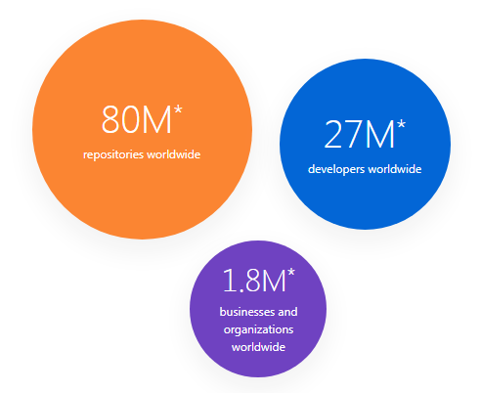





Data set
GitHub
80 Million repositories
27 Million Developers/users
More than 1.8 million* businesses and organizations use GitHub

Slide 9
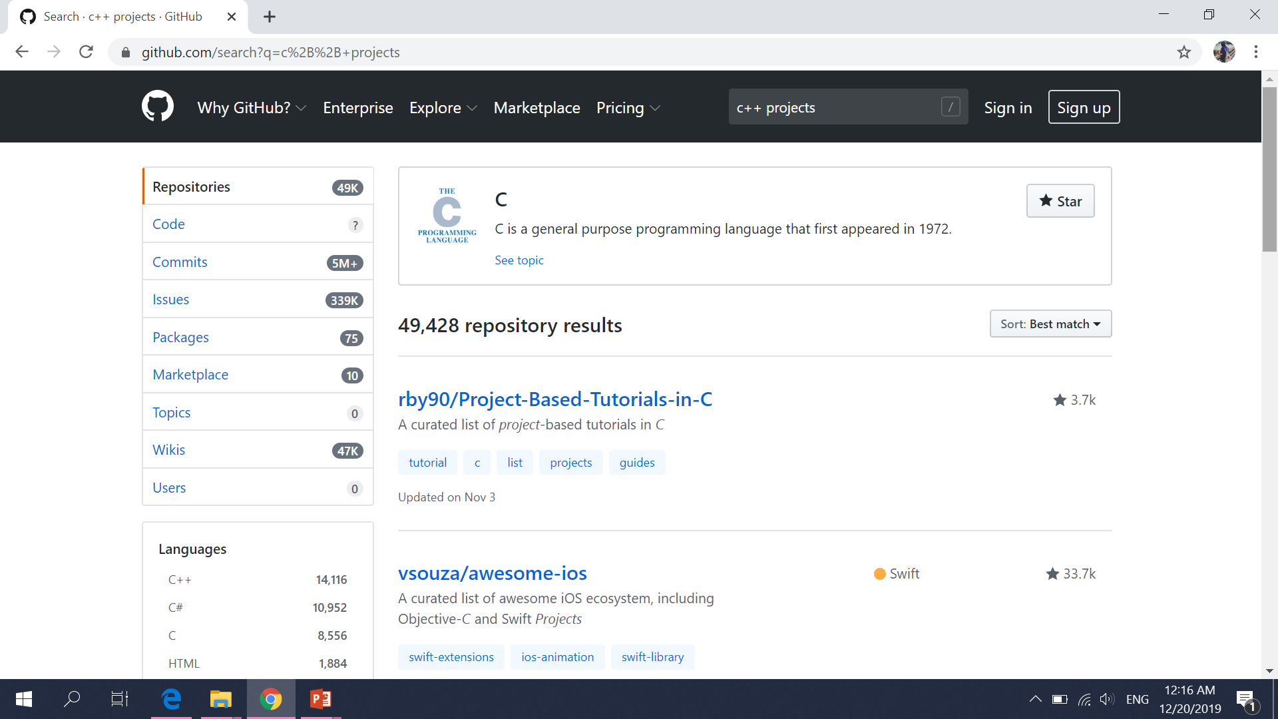

Slide 10


RESERCH QUESTIONS
RESERCH QUESTIONS
This work will effectively cater the answers of given questions by ranking the best code systematically on the basics of programming techniques and algorithms:
Access the executable files and source code either it gives some productive impact or not?
which source code is the most relevant according to given query?
How much of the retrieved code would execute?

Slide 11




Problem Statement
Finding reusable software components from online repositories and integrating them to the source code, is the most tiring work for software developers.
The software's Functional and Non-Functional requirements doesn’t meets the developer’s requirements every time.
reusable Component
Selection
Online
Component
Repository
Notes:
A functional requirement describes what a software system should do, while non-functional requirements place constraints on how the system will do so.

Slide 12
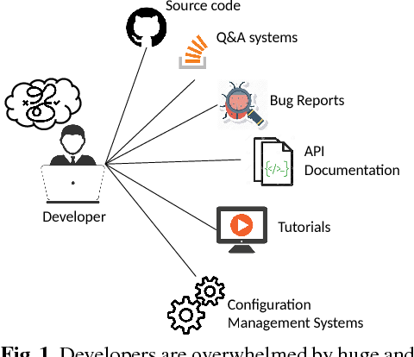

PURPOSE
Fig. 1. Developers are overwhelmed by huge and miscellaneous sources of supporting materials
Why Developers need CODEGO??
TIME
QUALITY
Notes:
We define five metrics for measuring a component's understandability, adaptability, and portability, with confidence intervals that were set by statistical analysis of a number
During the last few decades, with the rise of You-tube, Amazon, Netflix and many other such web services,
Reduce development time why because we are using existing soft components.
Reusable software components are already part of some other project, so using these in existing software ensures quality
and last use of exiting locks increase productivity. Less time to market
to ensure that the final software project is of high quality.
CBSE is easy to assemble and less costly to build the system constructed from discrete parts

Slide 13

solution
CODEGO recommender system proposed a code example by provide search facilities and learningto-rank techniques.
Better performance of our approach using the learning-to-rank technique can help code search engines place effective code examples at the top of result.
This system rank the codes and researches based on their reusability criteria.
Provides the reusability scores of the found results.

Slide 14

solution
We purpose a solution that makes code search concise and precise as much as possible.
Facilitate the user with various retrieval method, out of which they can select the one they deem fit for their purpose.

Slide 15

Objective
By examining all the research gaps and the problem statement, we have set following objectives:
To identify the issues related to the search and the retrieval of the components faced by the users.
To develop a software which extract the source code, documentation and all executable and reusable file and stored in local repository for ranking.
Increase the performance of components retrieval from repositories.

Slide 16

Scope
This work aims to provide ease to the software developers to do the online source code repositories and question answering communities.
The proposed solution facilitates the task of ﬁnding suitable (with respect to a developer query) source code according to given information.
It help the users to get personalized recommendations, helps users to take correct decisions during development process,
The work main aim is to provide accurate source_code recommendations to the user(developer). Finding and locating the desired code component consumes less time and effort.

Slide 17
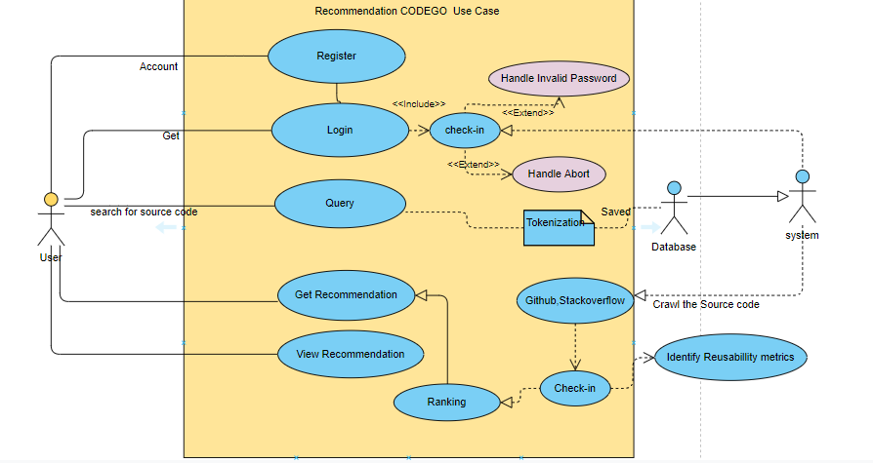
Methadologies
web crawling
Tokenization and store the token in database
Match with the repository
Rank the code
Recommend the result to the user

Slide 18
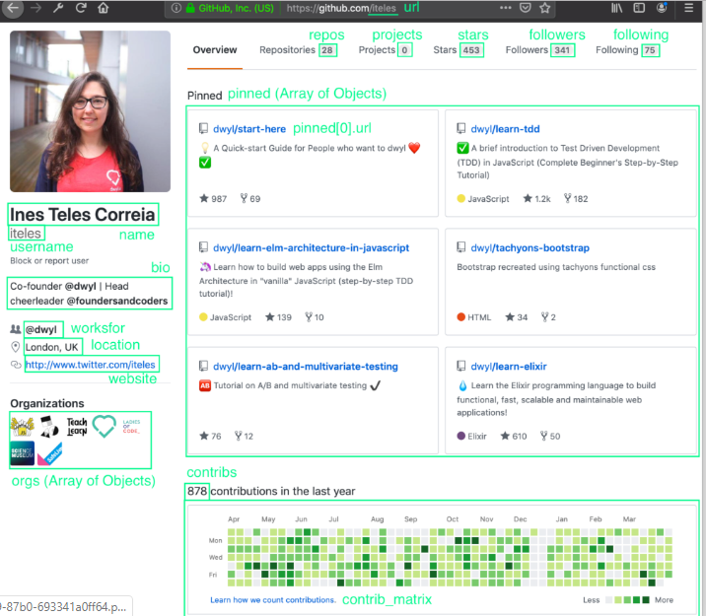

Slide 19
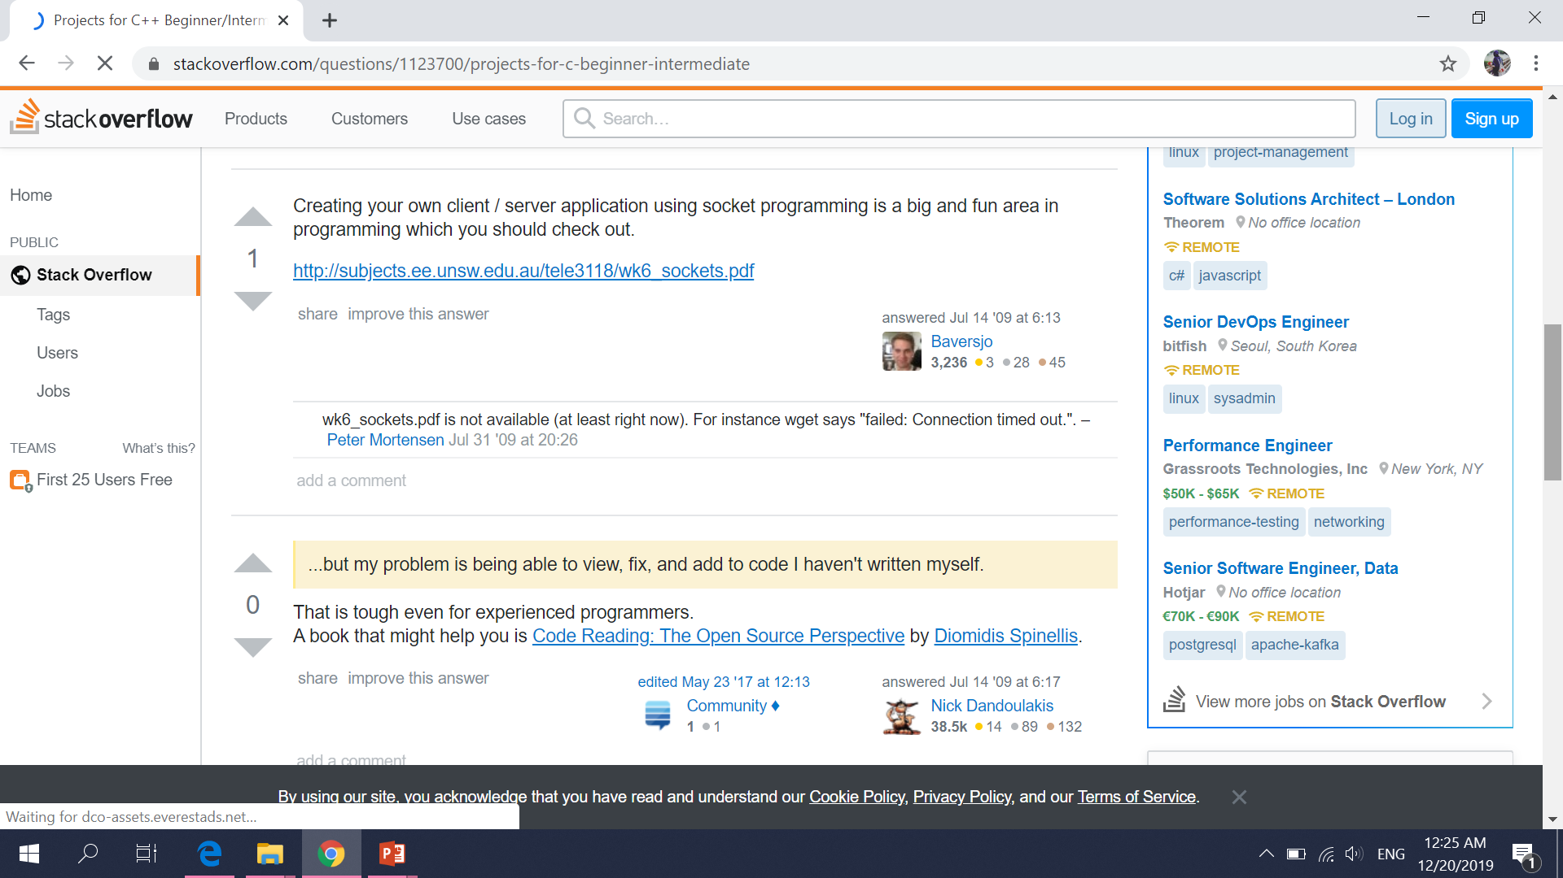

Slide 20

CONCLUTION
Although several systems have been developed for ﬁnding source code components, the assessment of the reusability of these components has not been adequately addressed.
Component Functional and reusability score is calculated. The functional score is measured on the basis of similarity between the user's query and Reusability scored is measured on the basis of the quality metric.
This CODEGO would recommend the source code snippets on the basis of query.
This system would get the functional and non functional requirements to recommend the desired results.

Slide 21

Thank you

